Slide 1
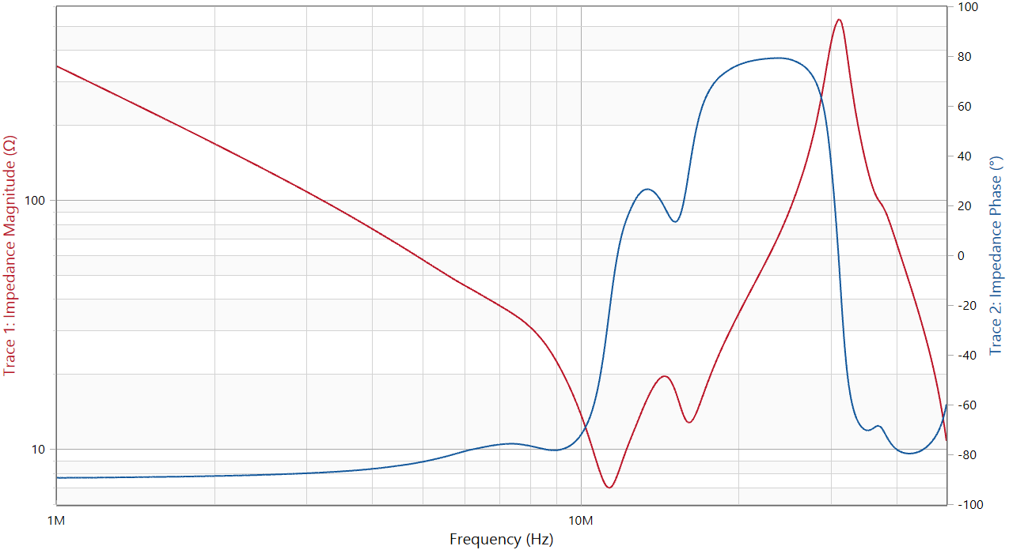
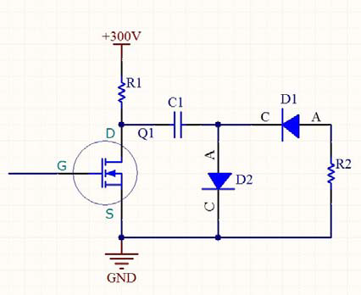
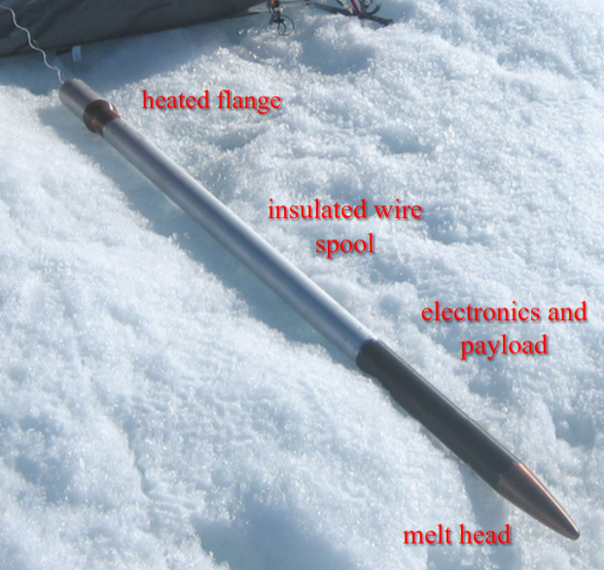
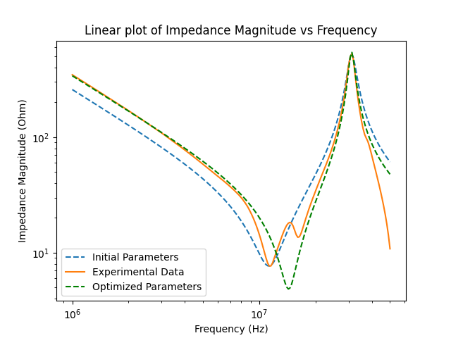
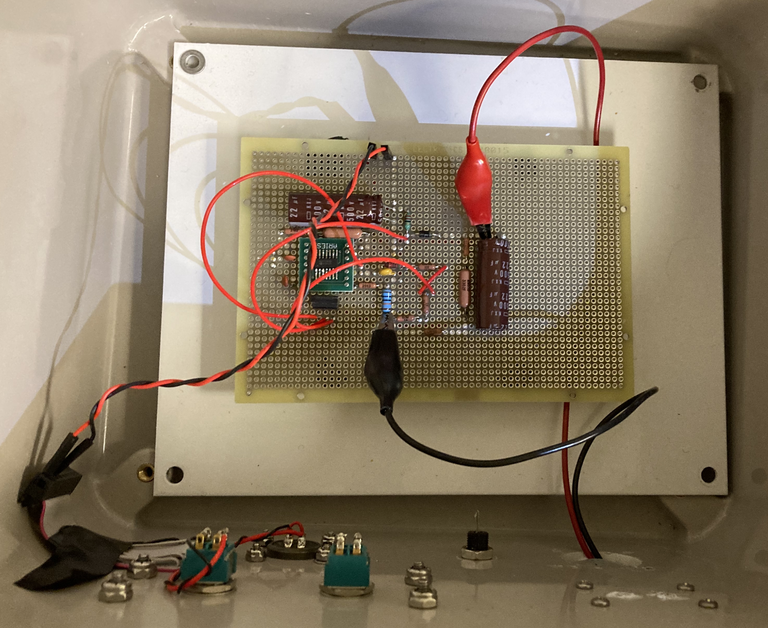
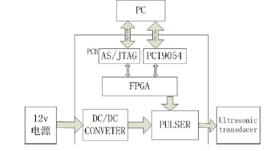
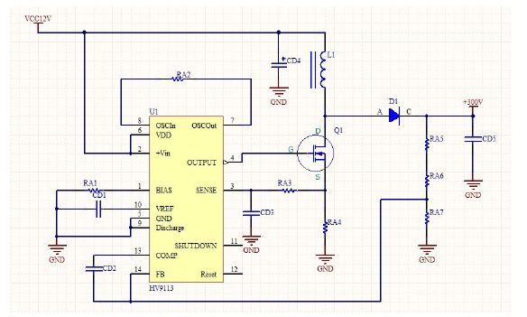
ACOUSTIC MEASUREMENT OF MELT JACKET THICKNESS AROUND A DESCENDING ICE MELT PROBE
23
STUDENTS: Cole Kaufmann, Emmett Miller, and Erik Petersen
Motivation
Transducer Analysis
Pulse Circuit
Subglacial lakes are some of the last unexplored regions of Earth.
Exploring these lakes could provide unique insight into environments analogous to those on other planets which may harbor extraterrestrial life.
Reaching a depth of 5 km with an ice melt probe could serve as a proof of concept for deployment to Antarctica.
Right now, the ice diver probe has no telemetry, limiting the depth it can reach.
By using a network analyzer we were able to characterize the impedance and phase characteristics of the transducer, an Olympus C544.
With a resonant frequency of 11.3 MHz, the transducer needs a pulse duration on the order of 0.1 μs.
Our pulse circuit will charge a capacitor, which is then quickly discharged when the MOSFET is open, providing the pulse needed to excite the transducer.
The primary feature of this circuit component is the charging and discharging of the capacitor. When the MOSFET shown is closed, current travels from the 300V source, through C1, through D2, and into ground, effectively charging the capacitor.
Once we want to discharge the capacitor, the MOSFET will receive a signal to open.
This will cause the charge stored in the capacitor to unload through the open MOSFET, into ground. Additionally, a current will be generated originating from the ground which flows through our load (shown as R2), and through D1 to replenish the missing charge from the capacitor. This high current burst will be the driving force to excite our transducer.
The Ice Diver
Equivalent Circuit
Our goal is to design and build a circuit to take acoustical measurements of ice jacket melt thickness around this descending ice probe.
To do this, we will excite an ultrasonic piezoelectric transducer with a 300V spike pulse, then measure the melt jacket thickness from the time difference between transmitted and received signals.
Due to high price of each transducer, an equivalent circuit was necessary for testing and analysis. We have chosen to use the Butterworth-Van Dyke (BVD) equivalent circuit model because of its robustness, simplicity, and documentation.
Initial equivalent circuit parameters were derived from our experimental transducer analysis and were further optimized using MatLab and Python to run a least-squares optimization algorithm. [2]
We determined that the BVD model is not sophisticated enough to describe the characteristics of our transducer completely.
[2]
Results
Over the last two quarters we have created our version of a customized DC/DC boost circuit, scaled down to fit inside the probe.
Though 12V to 300V voltage multiplier circuits are available for purchase, we opted to build our own due to hardware constraints: our circuit is well documented and can be scaled down to fit inside the probe, and it should withstand harsh Arctic conditions.
We have additionally sourced the components necessary to create
Implementation
DC/DC Boost Circuit
[2]
The driving principle of this DC/DC boost circuit is to store energy within the inductor which is then unloaded onto the output capacitor with a calculated resistance to ground, causing the capacitor to charge to 300V.
The energy is stored in the inductor by opening the MOSFET which allows current to flow through the inductor, through the MOSFET, and into ground.
both the pulse circuit and the equivalent circuit of the transducer.
Given an input of 12V, our prototype boost circuit outputs 200V for a short duration. This may be due to an insufficient power supply.
To excite the transducer, we will use a DC/DC boost circuit to generate 300V DC from the 12V DC available in the probe.
A pulser circuit takes the 300V source and uses a trigger signal from an FPGA to open and close a MOSFET, delivering a voltage spike to the transducer [1].
Once enough energy has been stored, the MOSFET is triggered to close, forcing this stored energy to discharge through the output branch, raising the voltage of the capacitor to 300V.
At the heart of this boost circuit is the HV9113 Pulse Width Modulator chip [4]. This chip controls when the MOSFET is open or closed by monitoring both the current traveling through the MOSFET and the voltage of the output.
[1] D. Xiao, J. Shao, H. Ren, and C. Xu, “Design of a high voltage pulse circuit for exciting ultrasonic transducers,” 2013 Far East Forum on Nondestructive Evaluation/Testing: New Technology and Application, 2013.
[2] R. Queirós, P. S. Girão, and A. C. Serra, “Single-Mode Piezoelectric Ultrasonic Transducer Equivalent Circuit Parameter Calculations and Optimization Using Experimental Data,” 2005.
[3] R. W. Sutliff, “The Effects of Loading on Equivalent Electric Circuit Models for Piezoelectric Transducers,” thesis, 2018.
[4] “High-Voltage Current-Mode PWM Controller.” Supertex Inc., Sunnyvale, CA, 2008.
ADVISORS: Dr. Dale Winebrenner
SPONSORS: Applied Physics Laboratory, University of Washington

